Slide 1
SVM-solution

Slide 2
Linear SVM:Separable case
KKT conditions:

Slide 3
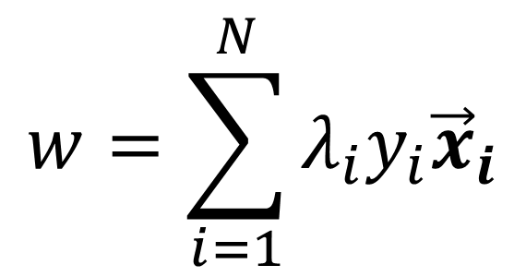
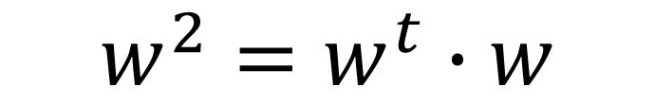
details
$$w^{2}=w^{t}∙w$$
$$w=\sum_{i=1}^{N}{λ_{i}y_{i}{\vec{x}}_{i}}$$

Slide 4
Replace (5.39) for w and (5.40) into (5.38)
we get:

Slide 5
Some important points
According to (5.42): λ_{i}> 0 only when
y_{i}(w⋅x_{i}+b)-1=0;
That is, only data point lies on the supporting plane are needed for determining w and b; these data points are called the support vectors.
The dual Lagrangian involves only the Lagrange multipliers and the training data, while the primary Lagrangian involves the Lagrange multipliers as well as parameters of the decision boundary.
The solutions for both optimization problems are equivalent.

Slide 6
The quadratic term in Equation 5.43 has a negative sign, which means that the original minimizatio problem of the primary Lagrangian LP, has turned into a maximization problem involving the dual Lagrangian, LD
The decision boundary can be expressed as
b can be found by equation (5.42) with only the support vectors

Slide 7
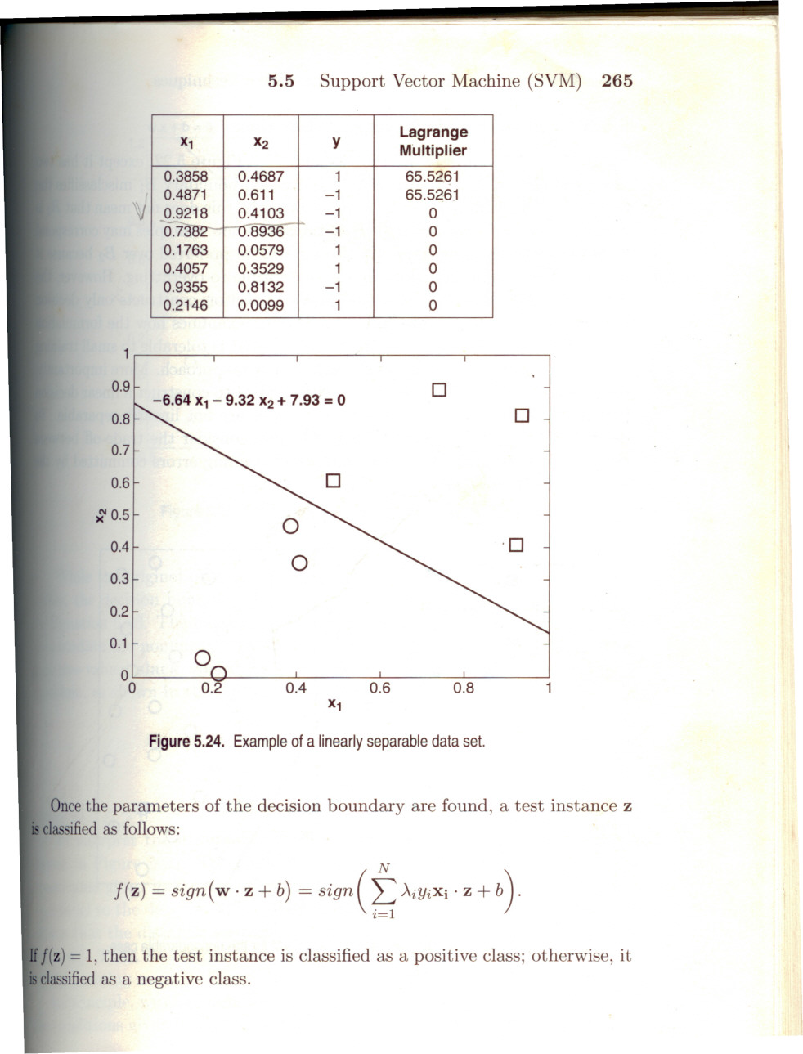
A linear separable example

Slide 8
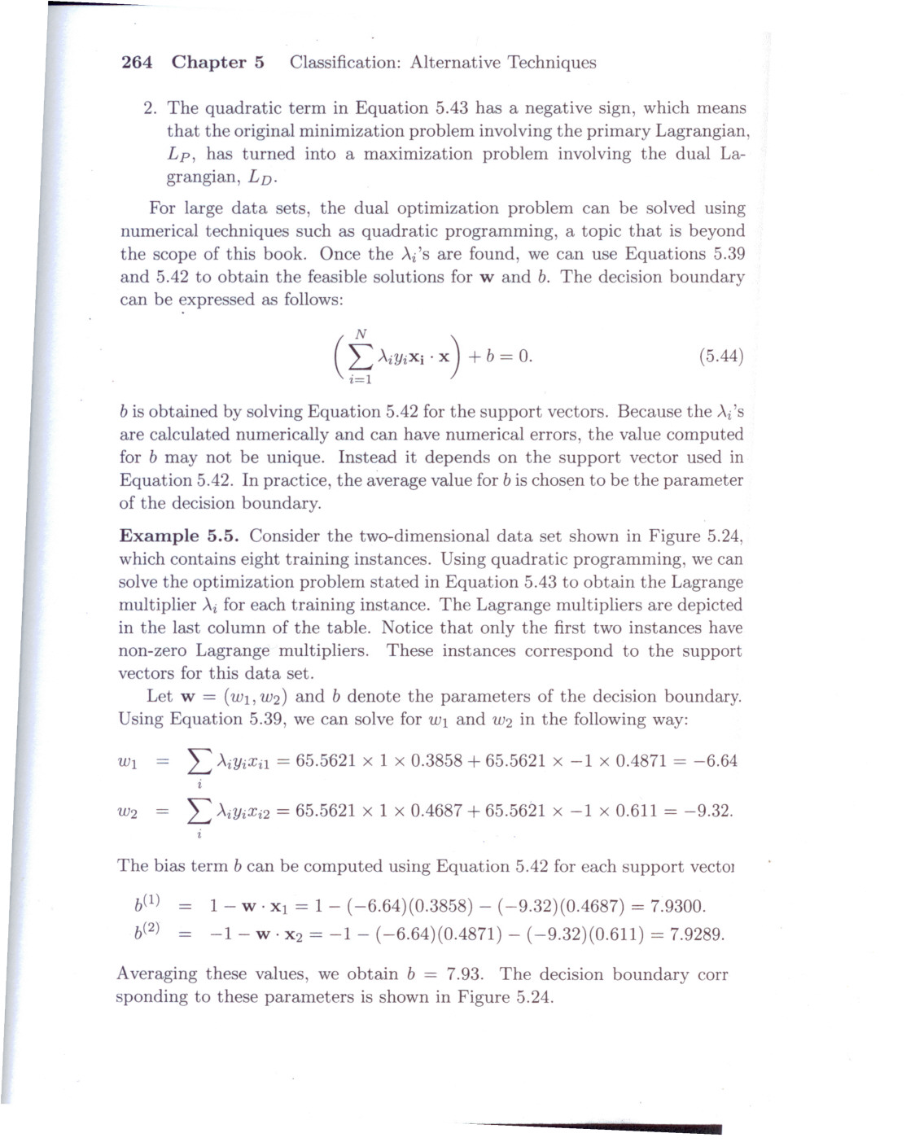

Slide 9
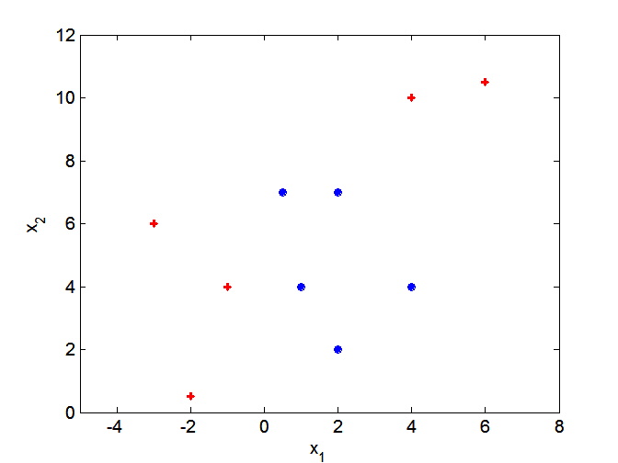
Nonlinear Support Vector Machines
What if decision boundary is not linear?

Slide 10
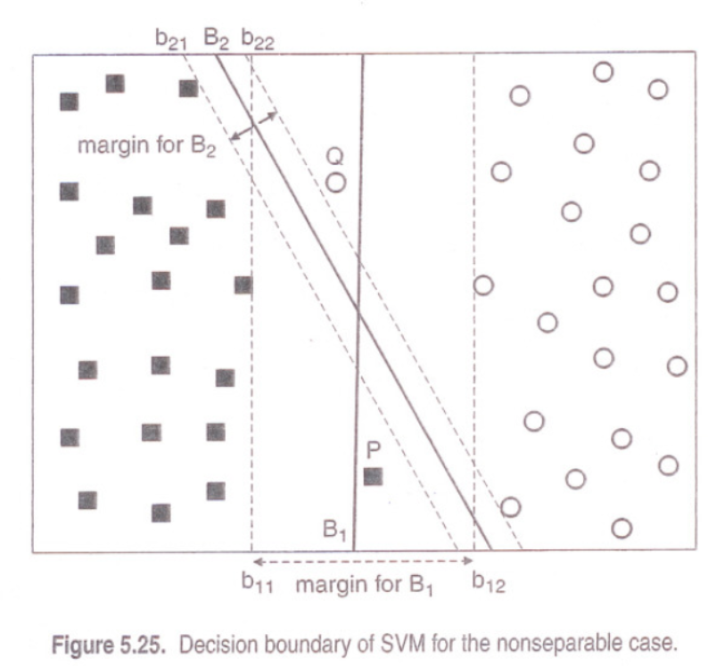
Linear SVM:Nonseparable

Slide 11
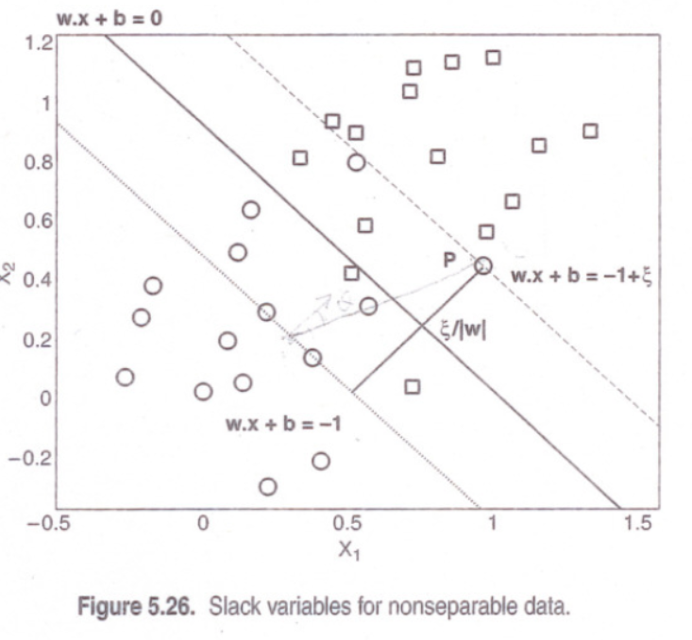

Slide 12
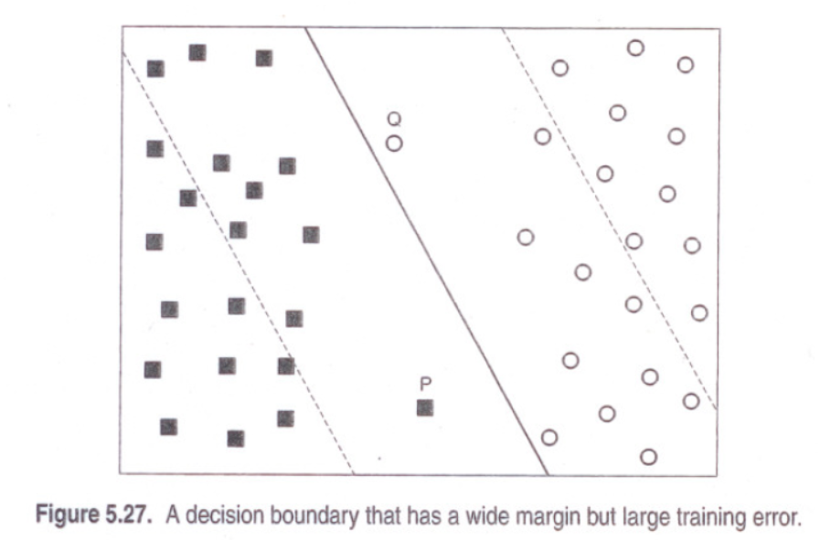

Slide 13
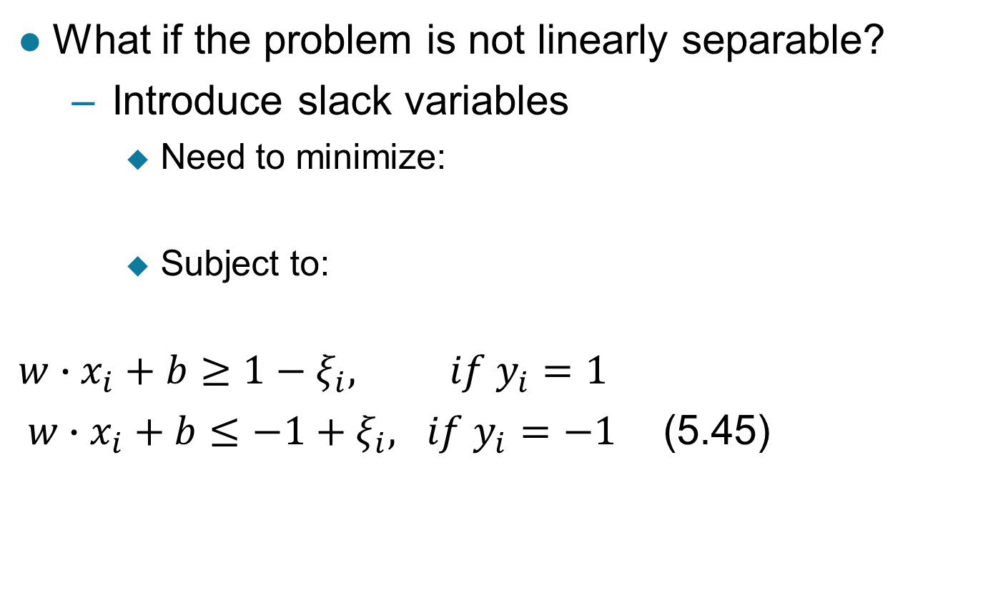
Linear SVM:Nonseparable
What if the problem is not linearly separable?
Introduce slack variables
Need to minimize:
Subject to:
$$w∙x_{i}+b≥1−ξ_{i}, if y_{i}=1$$
$w∙x_{i}+b≤−1+ξ_{i}, if y_{i}=−1$ (5.45)

Slide 14
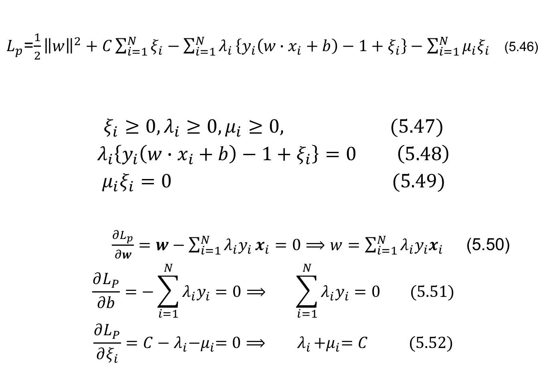
$L_{p}$=$\frac{1}{2}{\left\|w\right\|}^{2}+C\sum_{i=1}^{N}{ξ_{i}−\sum_{i=1}^{N}{λ_{i}}}\left\{y_{i}\left(w∙x_{i}+b\right)−1+ξ_{i}\right\}−\sum_{i=1}^{N}{μ_{i}ξ_{i}}$ (5.46)
$$ξ_{i}≥0, λ_{i}≥0, μ_{i}≥0, (5.47)$$
$$λ_{i}\left\{y_{i}\left(w∙x_{i}+b\right)−1+ξ_{i}\right\}=0 \left(5.48\right)$$
$$μ_{i}ξ_{i}=0 (5.49)$$
$\frac{∂L_{p}}{∂w}=w−\sum_{i=1}^{N}{λ_{i}y_{i}}x_{i}=0⟹w=\sum_{i=1}^{N}{λ_{i}y_{i}x_{i}}$ (5.50)
$$\frac{∂L_{P}}{∂b}=−\sum_{i=1}^{N}{λ_{i}y_{i}=0⟹ \sum_{i=1}^{N}{λ_{i}y_{i}=0 (5.51)}}$$
$$\frac{∂L_{P}}{∂ξ_{i}}=C−λ_{i}{−μ}_{i}=0⟹{ λ}_{i}{+μ}_{i}=C (5.52)$$

Slide 15
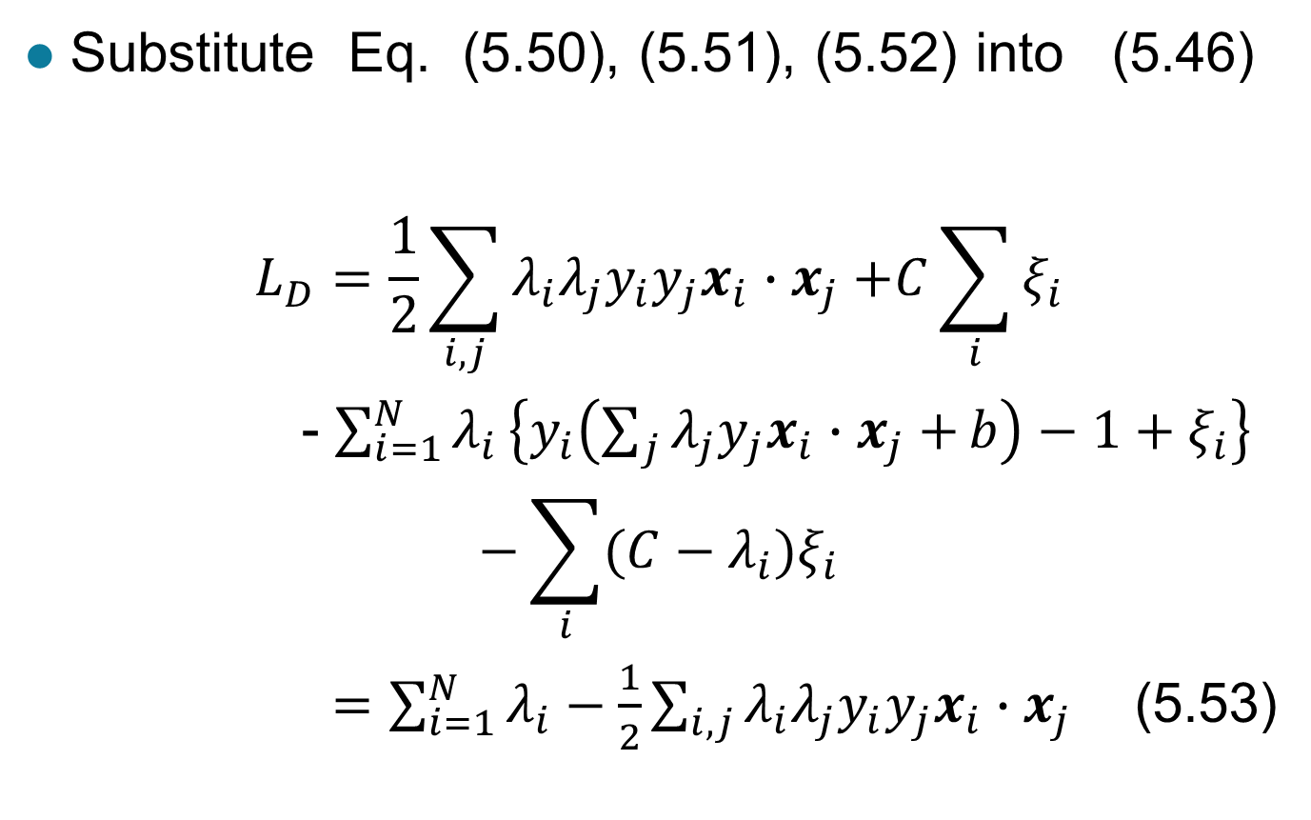
Substitute Eq. (5.50), (5.51), (5.52) into (5.46)
$$L_{D}=\frac{1}{2}\sum_{i,j}{λ_{i}λ_{j}{y_{i}y_{j}x}_{i}{∙x}_{j}+C\sum_{i}{ξ_{i}}}$$
- $\sum_{i=1}^{N}{λ_{i}}\left\{y_{i}\left(\sum_{j}{λ_{j}y_{j}x_{i}{∙x}_{j}+}b\right)−1+ξ_{i}\right\}$
$$−\sum_{i}{(C−λ_{i})ξ_{i}}$$
$=\sum_{i=1}^{N}{λ_{i}−\frac{1}{2}\sum_{i,j}{λ_{i}λ_{j}y_{i}y_{j}x_{i}{∙x}_{j}}}$ (5.53)

Slide 16
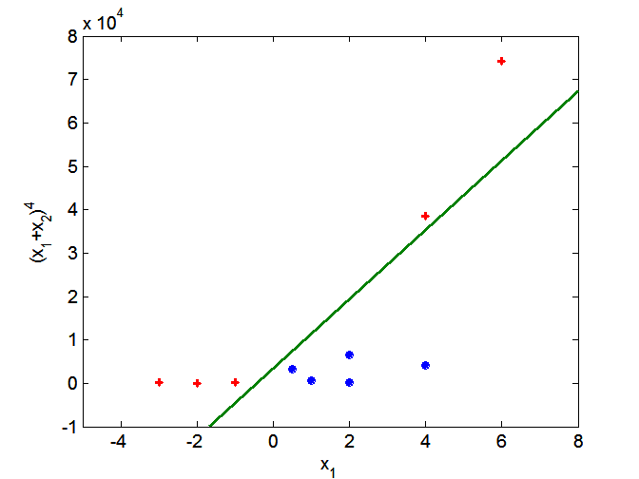
Nonlinear Support Vector Machines
Use mapping a func. φ to map data into another space

Slide 17
Nonlinear SVM
Min
Subject to y_{i} (wφ(x_{i})+b)≥0, i=1,2,…,N

Slide 19
To solve equation (56), we need to calculate
The inner product of two high dimensional vectors, it’s costly!
So, people come up with the kernel trick to simply the calculation of
Inner product of two mapped vectors.

Slide 20
Kernel Trick
Note that the mapping function is
A function of the inner product of two vectors. The function value is equal to the
inner product of the two mapped higher dimensional vectors.

Slide 21
Decision boundary with kernel function

Slide 22
Characteristics of SVM
The SVM learning problem can be formulated as a convex optimization problem, in which global optimal can be obtained.
SVM performs capacity control by maximizing the margin of the decision boundary. User must provide parameters such as the type of kernel function and the cost function C.
The SVM can be extended to multiclass problem.

